Slide 1
Basic Definitions & Terms

Slide 2
Housing & Urban Development
At the end of this session, you would be able to define:
House, Housing, Affordable housing, Formal Housing ,Informal Housing ,Shelter, Housing census, Squatter Settlements, Slums, Land speculation ,Major types of Houses across world

Slide 3
“Safe, affordable housing is a basic necessity for every family. Without a decent place to live, people cannot be productive members of society, children cannot learn and families cannot thrive.”
Tracy Kaufman, Research Associate
National Low Income Housing Coalition/
Low Income Housing Information Service

Slide 4
House
A building that serves as living quarters for one or a few families
A building for human habitation, especially one that consists of a ground floor and one or more upper storeys.
A dwelling for a group of people, such as students or members of a religious community, who live together as a unit

Slide 5
Housing
Buildings or structures that individuals and their family may live in that meet certain regulations. Different housing situations vary for individuals and may depend on age, family, and geographic location.
Anything that cover, protects, or supports another thing. For example, the casing of a desktop computer is its housing component and can be made of multiple materials to protect the internal components.

Slide 6
Formal Housing
Formal housing is used as a proxy for ‘adequate’ housing.
Areas where group of housing units have been constructed on land that the occupants have occupied legally.
Planned settlements and areas where housing is in compliance with current planning and building regulations.

Slide 7
Informal Housing
Areas where groups of housing units have been constructed on land that the occupants have no legal claim to, or occupy illegally.
Unplanned settlements and areas where housing is not in compliance with current planning and building regulations (unauthorized housing).

Slide 8
Affordable Housing
Affordable housing refers to housing units that are affordable by that section of society whose income is below the median household income.
Though different countries have different definitions for affordable housing, but it is largely the same, i.e. affordable housing should address the housing needs of the lower or middle income households. Affordable housing becomes a key issue especially in developing nations where a majority of the population isn't able to buy houses at the market price.

Slide 9
Shelter
Something beneath, behind, or within which a person, animal, or thing protected from storms, missiles, adverse conditions, etc.; refuge.
A dwelling place or home considered as a refuge from the elements:

Slide 10
Difference Between Shelter and House
The main difference is the length of time a person is able to stay in the facility. Shelters normally house people for a short period of time – up to 3 months while a House is a place where a family normally resides for a longer period of time. In an other words we can say that shelter is a sort of cover for temporary protection.

Slide 11
Housing Census
A housing census is the total process of collecting, compiling, evaluating, analyzing and publishing or otherwise disseminating statistical data pertaining, at a specified time, to all living quarters and occupants thereof in a country or in a well-delimited part of a country.

Slide 12
Squatter Settlements
Definition of a squatter settlement varies widely from country to country and depends on a variety of defining parameters.
In general, it is considered as a residential area in an urban locality inhabited by the very poor who have no access to tenured land of their own, and hence "squat" on vacant land, either private or public.

Slide 13
Squatter Settlements
There are a number of names by which squatter settlement are described by various authors, which highlight the attitudes and approaches towards them, ranging from a positive to neutral to negative outlook. These are:
  Informal settlements
  Low-income settlements
  Semi-permanent settlements
  Shanty towns
  Spontaneous settlements
  Unauthorized settlements
  Unplanned settlements
  Uncontrolled settlements

Slide 14
Squatter Settlements
There are a number of names by which squatter settlement are described by various authors, which highlight the attitudes and approaches towards them, ranging from a positive to neutral to negative outlook. These are:
  Informal settlements
  Low-income settlements
  Semi-permanent settlements
  Shanty towns
  Spontaneous settlements
  Unauthorized settlements
  Unplanned settlements
  Uncontrolled settlements

Slide 15
Squatter Settlements
Some of the local/colloquial names for squatter settlements (often also used for slum settlements)
  Ranchos = Venezuela
  Callampas, Campamentos = Chile
  Favelas = Brazil
  Barriadas = Peru
  Villas Misarias = Argentina
  Colonias Letarias = Mexico
  Barong = Philippines
  Kevettits = Burma
  Gecekondu = Turkey
  Bastee, Juggi, johmpri = India and
  Katchi Abadi = Pakistan

Slide 16
Slum
Slum communities are defined by poverty, low income, inadequate living conditions and sub-standard facilities.
These communities are usually inhabited by socially disadvantaged people (people regarded as lower caste). Unlike squatter settlements, the residents of these slum areas generally own their land and houses, which are very small in size and have formal title papers to prove their ownership. These communities are also officially recognized by authorities
A dangerous and dirty part of town is an example of a slum.
A building that is falling down and in disrepair is an example of a slum.

Slide 17
Land Speculation
Activity in which someone buys and sells land in the hope of making a large profit .
Land Speculator
A land speculator is someone who buys land with the sole intention of selling it on for a profit.

Slide 18
Types of Houses in in terms of material used
Kaccha (mud made)
Pacca (kiln made bricks)
Semi-Pacca (mud and brick made)

Slide 19
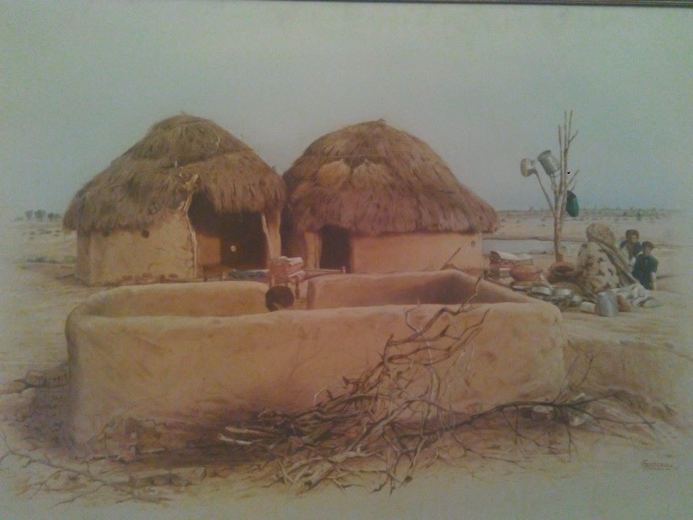
Kacha (mud made)
Kacha houses, constructed of less-durable material (e.g., mud, bamboo, reeds, or thatch)
According to Gallup world bank report 39 percent of the total houses are kacha (temporary) houses with minimal water supply and sanitation or drainage services

Slide 20
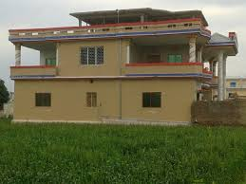
Pacca (kiln made bricks)
Pukka houses are built of substantial material such as stone, brick, cement, concrete, or timber.
As per latest figure of world bank and united nations only 21 percent of the houses inside Pakistan are modern brick constructions.

Slide 21
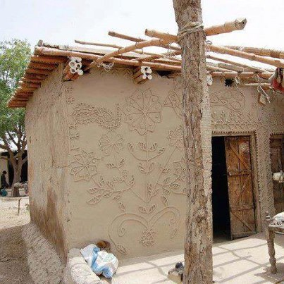
Semi-Pucca (mud and brick made)
Semi Pacca houses are mix of above mentioned two.
According to World Bank Report approximately 40 percent of houses are semi-pucca (semi-permanent) houses, most without planned sanitation or sewerage systems.

Slide 22
Housing types
There can be many other types as well on the basis of number of other criteria's.

Slide 23
References
World Bank, 2010 ‘Expanding Housing Finance to the Underserved in South Asia’

